Slide 1


HomeLink Addis
The Future of Workforce Supply: Secure, Verified, and Efficient Domestic & International Placement
November 2025

Slide 2

The Challenge: Unverified & Inefficient Workforce Supply
The Problem
Our Solution
High Risk of Fraud
Secure Platform
Unverified workers, age fraud, and lack of accountability plague the traditional supply chain.
HomeLink Addis provides a centralized, fully verified platform connecting workers with employers and agencies.
Inefficient Recruitment
Multi-Channel Access
Workers from rural areas face barriers to accessing job opportunities in Addis Ababa.
Workers can register via WhatsApp, TikTok, Telegram, and IMO, maximizing accessibility.
Employer Risk
Trust Guarantee
Families and agencies have no reliable way to verify worker credentials or background.
We offer a 1-Month Replacement Guarantee to build client confidence and reduce hiring risk.

Slide 3

A Scalable Model: Two Primary Customer Segments
Worker Supply
Recruit, register, house, and manage a pool of vetted domestic workers
HomeLink Addis Platform
Centralized verification, management, and placement system
Segment 1: Family Employers
Segment 2: Agencies (B2B)
Direct placement for domestic work in Addis Ababa homes
Reliable source of pre-vetted candidates for international market
Revenue: Subscription Fees
Revenue: Subscription Fees

Slide 4

Reaching the Workforce: Registration via Messaging Platforms
💬
🎵
✈️
📱
WhatsApp
TikTok
Telegram
IMO
Ubiquitous messaging platform with high adoption in Ethiopia
Reaches younger demographics and rural populations
Secure, fast, and popular among tech-savvy users
Low-bandwidth alternative for users with limited data
Key Benefits & Impact
Accessibility
Low-Barrier Entry
Workers in rural areas with limited internet access can initiate registration by sending a National ID photo to a dedicated account.
Simple process ensures a larger, more diverse talent pool by meeting workers where they already communicate.
Rapid Onboarding
Market Reach
Workers receive automated responses and are guided to complete registration via the mobile-friendly web portal.
Multi-platform presence ensures HomeLink reaches workers across diverse communication preferences and demographics.

Slide 5

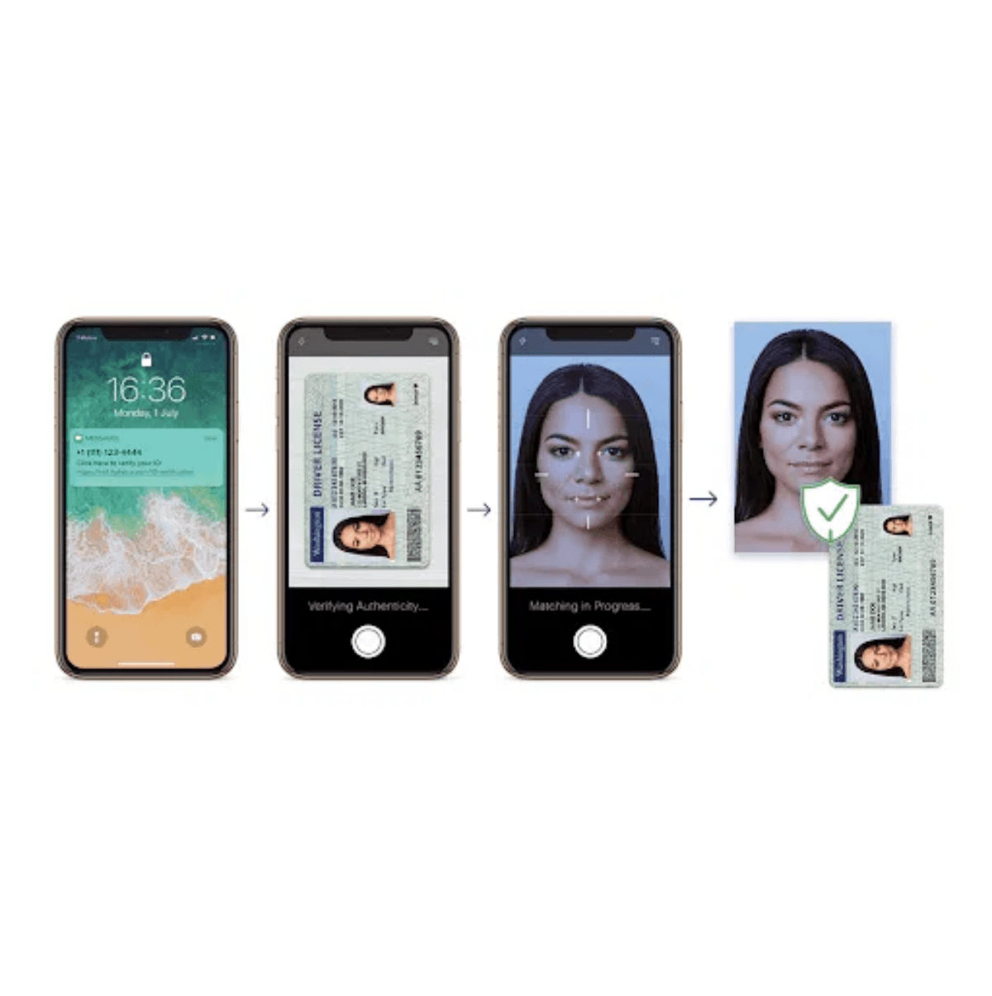
Zero Tolerance: Mandatory Age and Contact Verification
1
Age Verification (18+)
Automated OCR scan of National ID ensures all workers are 18 years or older. Registration is immediately halted if underaged, ensuring legal compliance.
2
Emergency Contact Verification
Worker must provide the National ID of their emergency contact. System verifies the contact's ID is from the worker's original ruler area before travel to Addis.
✓
Impact
Ensures legal compliance and provides a reliable, verified point of contact in the worker's home community for accountability and safety.

Slide 6

Professionalizing the Workforce: Automated CV Generation
1
Auto-CV Generation
Upon successful verification and completion of the Skill & Experience Self-Assessment, the system automatically compiles all verified data (Skills, Experience, Training Badges) into a professional, standardized CV in PDF format.
2
Centralized Database
The database serves as the single source of truth for all worker profiles, ensuring consistency and accuracy across the platform. All CVs are securely stored and indexed for quick retrieval.
3
Resource Sharing
The system is designed to share this resource with all authorized parties: Family Employers access worker profiles via the Employer Portal, and Local & Foreign Agencies access Auto-CVs and use Bulk Export/CV Download functionality.
🔒 Security & Privacy
No direct contact information (phone, address) is revealed to employers/agencies until a formal hiring process is initiated. The platform maintains its role as the trusted intermediary.

Slide 7


Worker Management: From Registration to Placement
Registration Data Capture
Personal Bio-Data (Name, Age, Photo, Phone)
National ID (Kebele ID) via OCR scan
Skill & Experience Self-Assessment
Job Preferences (Live-in/Live-out)
Status Dashboard
Profile Completeness Indicator
Application Status Tracking
Digital Profile Card (Printable)
Training Modules
House Safety Basics
Professional Behavior Training
Hygiene Standards
Addis Workplace Etiquette
Accommodation Center
Digital Worker Profile
Temporary Housing & Check-in/Check-out
Staff Notes & Progress Tracking

Slide 8


The Domestic Market: Easy & Trustworthy Hiring
Light Vetting
Employers register with ID and address. Quick verification ensures legitimacy.
Search & Filter
Search by Skills, Age Range, Experience Level, and Live-in/Live-out preferences.
Hiring Workflow
"Request Interview" and "Hire This Worker" buttons streamline the process. Digital contracts included.
1-Month Replacement Guarantee
If unsatisfied within 30 days, receive a free replacement. Building trust through confidence.

Slide 9
The International Market: Bulk Supply & Advanced Tools
1
2
Stricter Vetting
Advanced Search Filters
Agencies register with business name, license number (MOLSA), and contact details.
All Family Portal filters plus international-specific options.
Passport Holder status
▪
Manual business license verification
▪
Willing to work abroad
▪
MOLSA compliance check
▪
Travel readiness indicators
▪
Ensures legitimacy of B2B partners
▪
3
4
Bulk Operations
Bulk Export & CV Download
Agencies can efficiently manage multiple candidates at scale.
Download comprehensive candidate packages instantly.
Shortlist multiple candidates into folders
▪
ZIP file with Auto-CVs of all shortlisted workers
▪
Track shortlist status in real-time
▪
Request Full Profile for detailed information
▪
Manage candidate pipelines
▪
Streamlined candidate submission process
▪
HomeLink provides a reliable, pre-vetted supply chain for international placement agencies, reducing recruitment time and ensuring quality candidates.

Slide 10

The HomeLink Process: A Secure Data Flow
1
2
3
4
5
Register
Verify
Approve
Place
Feedback
Worker data captured via multi-channel intake
Age Check (18+) & Emergency Contact Origin Match
Staff vet profile. Auto-CV generated
Family Employer or Agency placement
Post-placement feedback & Trust Score update
Replacement Guarantee Timer
Trust Score Impact
Starts at placement. Free replacement available within 30 days if unsatisfied.
Feedback from employers/agencies updates worker's Trust Score, affecting future placement opportunities.

Slide 11

Why HomeLink Wins: Security, Scale, and Trust
🔒
📱
Unmatched Verification
Accessibility & Scale
Mandatory 18+ age check and Emergency Contact Origin verification from the worker's home region. A key differentiator that ensures legal compliance and accountability.
Multi-channel registration via WhatsApp, TikTok, Telegram, and IMO ensures the largest pool of workers, especially from rural areas with limited internet access.
✅
📄
Risk Mitigation
Professionalization
1-Month Replacement Guarantee for Family Employers reduces hiring risk and builds confidence. Employers can hire with peace of mind.
Auto-CV generation and standardized training modules elevate worker quality and credibility. Professional presentation increases placement success.

Slide 12


Invest in the Future of Workforce Supply
Join us in transforming how Ethiopia connects workers with opportunity.
Our Vision
To be the single most trusted and efficient source of domestic and international workforce supply in Ethiopia, ensuring safe, verified, and dignified employment for thousands of workers.
For Investment Inquiries:
Contact: [Your Contact Information]
Email: [Your Email Address]
Phone: [Your Phone Number]

